Slide 1
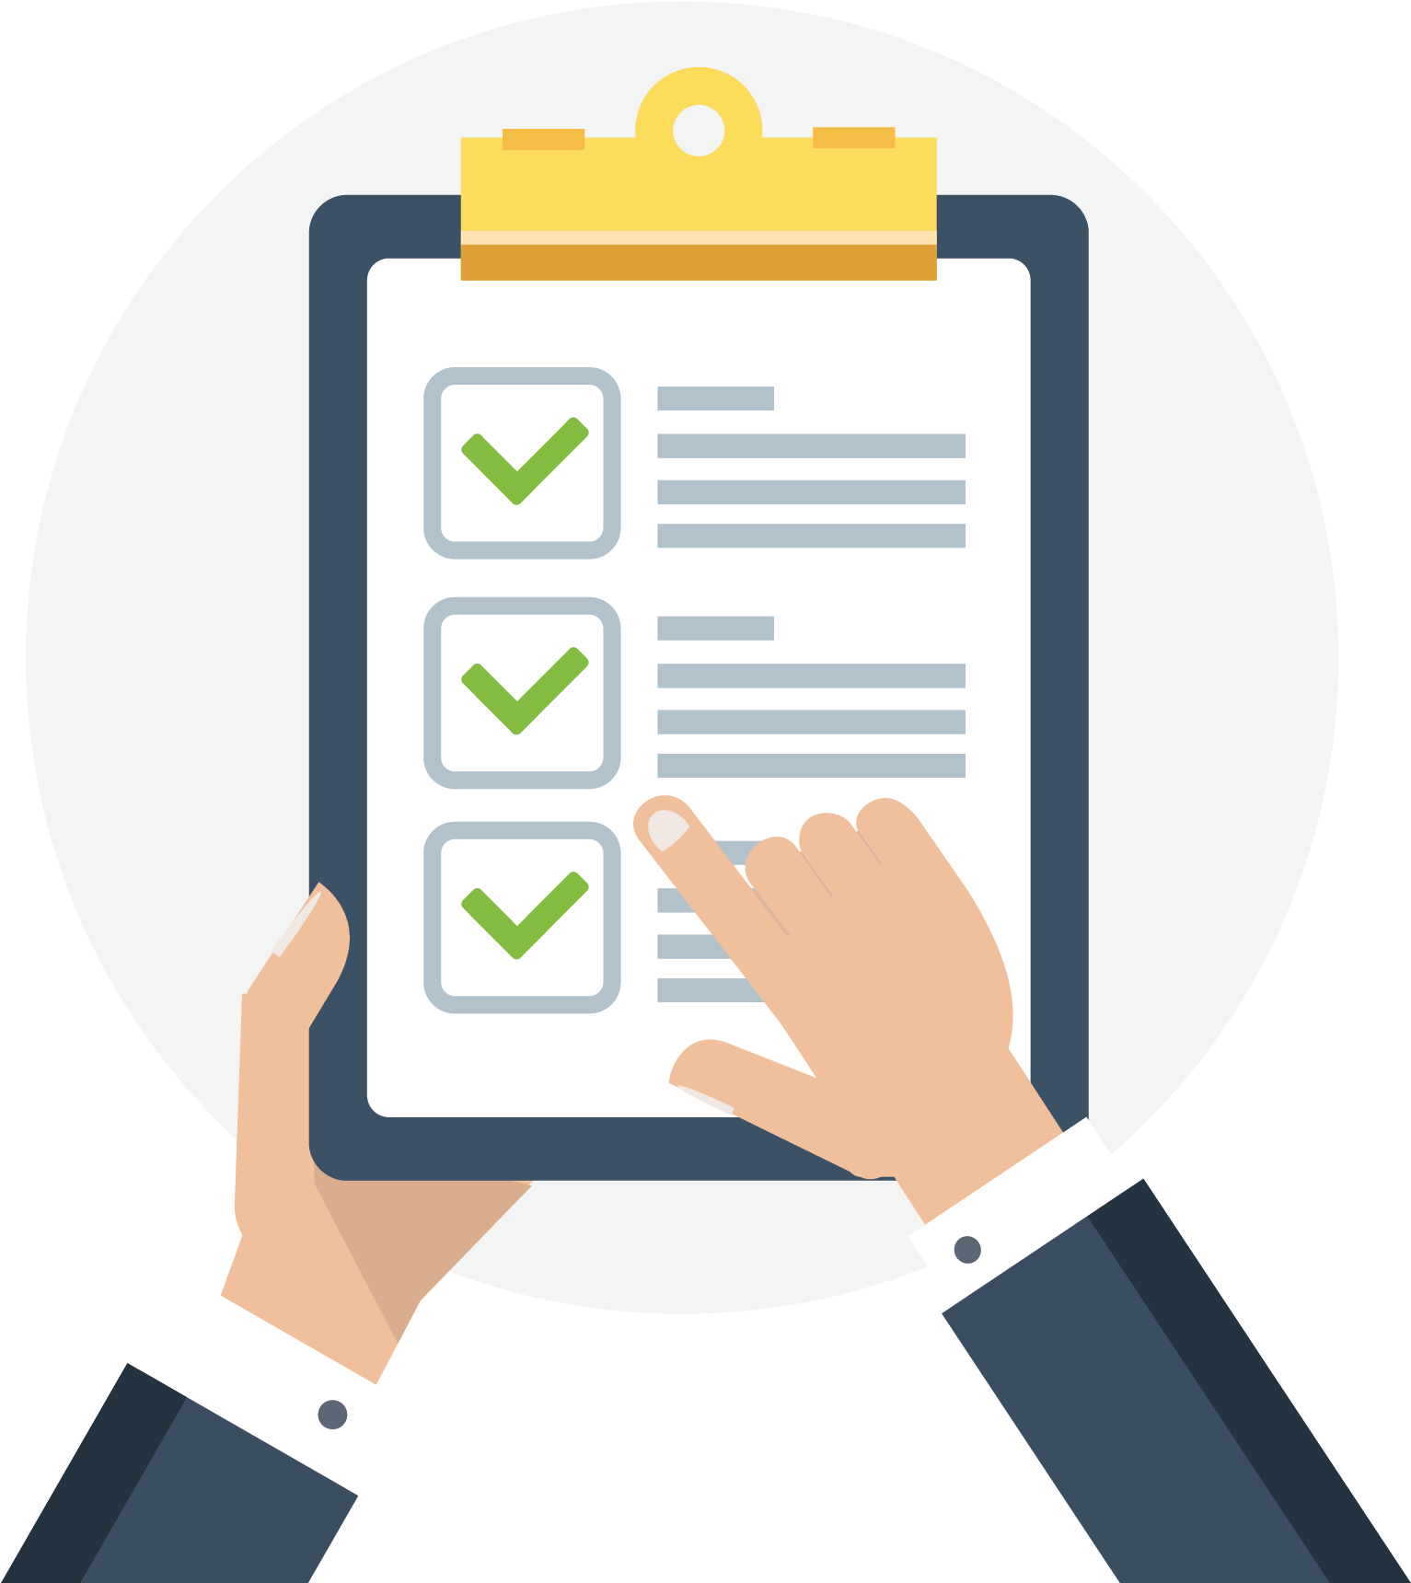
To-do Application

Slide 2


Team:-
Durgam Prashanth
Akhil Birru

Slide 3
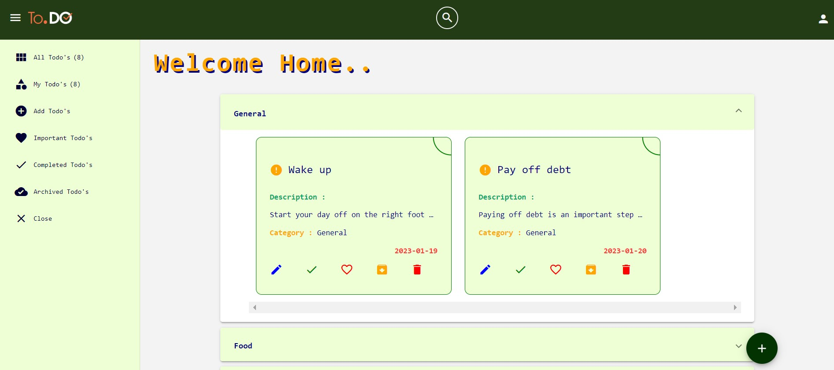
To-do List:
Captures quick ideas, check tasks off your To-Do list, and much more.
One of the fundamental features for any productivity tool is a To-Do list. With the To-Do Tracker, you can create and share notes and lists.
The To-Do Tracker helps you to accomplish a set of tasks in order to achieve a goal wherever you are. In today’s world, many of us, use apps on our phones to manage our tasks. To-Do Tracker surfaces the right tasks at the right time, so you always know what to focus on next.

Slide 4
Benefits
Improved productivity: To-do apps help users stay organized and on track by providing an easy way to create and manage tasks. This can help users prioritize their work and get more done in less time.
Better time management: To-do apps allow users to set reminders and deadlines, which can help them stay on top of important tasks and manage their time more effectively.
Improved organization: To-do apps allow users to categorize and tag their tasks, making it easy to find and reference specific tasks later.

Slide 5
Features of To-do-App
Add and categorize tasks
Organize your tasks
Modify the tasks as required
Remove the task completed from the list
Archive tasks
Important tasks
To-do prioritization
Filter through To-do’s

Slide 6
Technologies Used
Front-End:-
Angular - 14.2.10
Angular Material - 13.0.0
Html
CSS
TypeScript
Back-End:-
Spring Boot – 2.7.7
Micro services
API Gate Way
Eureka Server
Feign Client
RabbitMQ
Docker

Slide 7


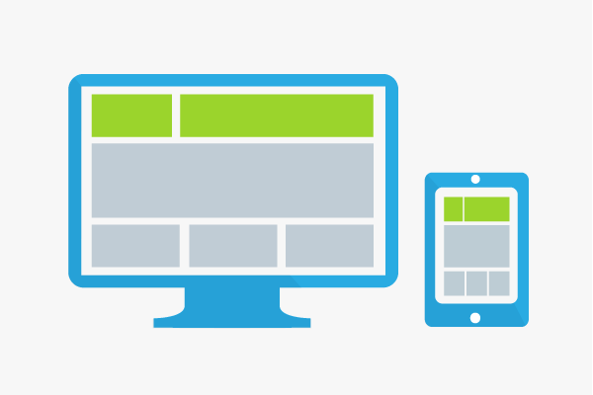

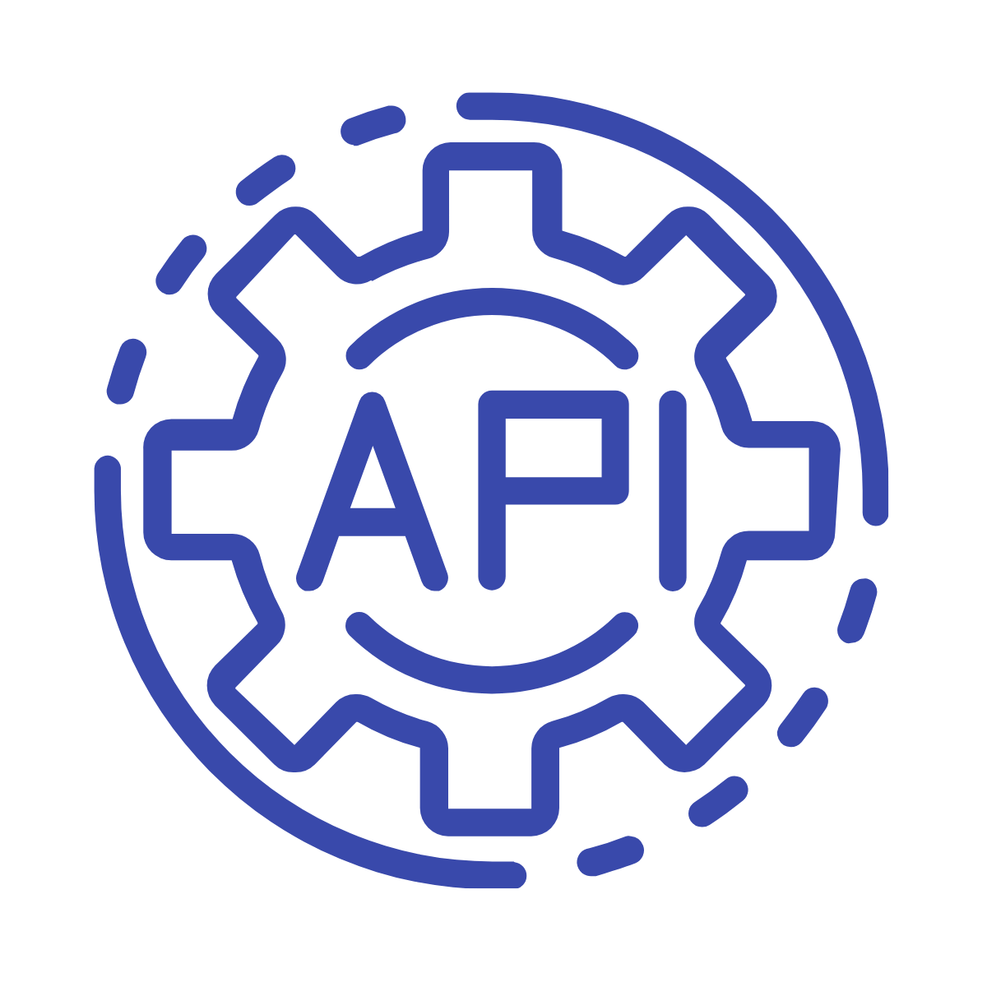




To-Do Architecture
Mysql
Authentication-
service
Fiegn Client
To-do
-service
Eureka Server
Notification Service
Note: Eureka Server will Monitor all registered Microservices

Slide 8
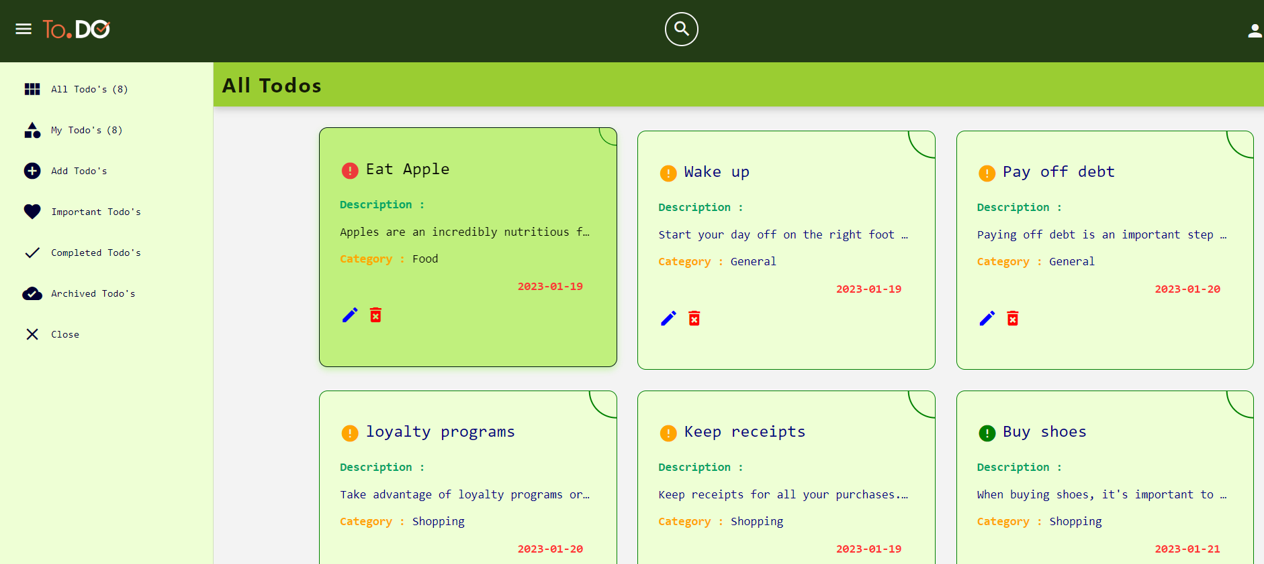
Project Demonstration

Slide 9
Future Enhancement
Reminders about the task
Social sharing
Multi-select
Subtasks
Customizable backgrounds

Slide 10
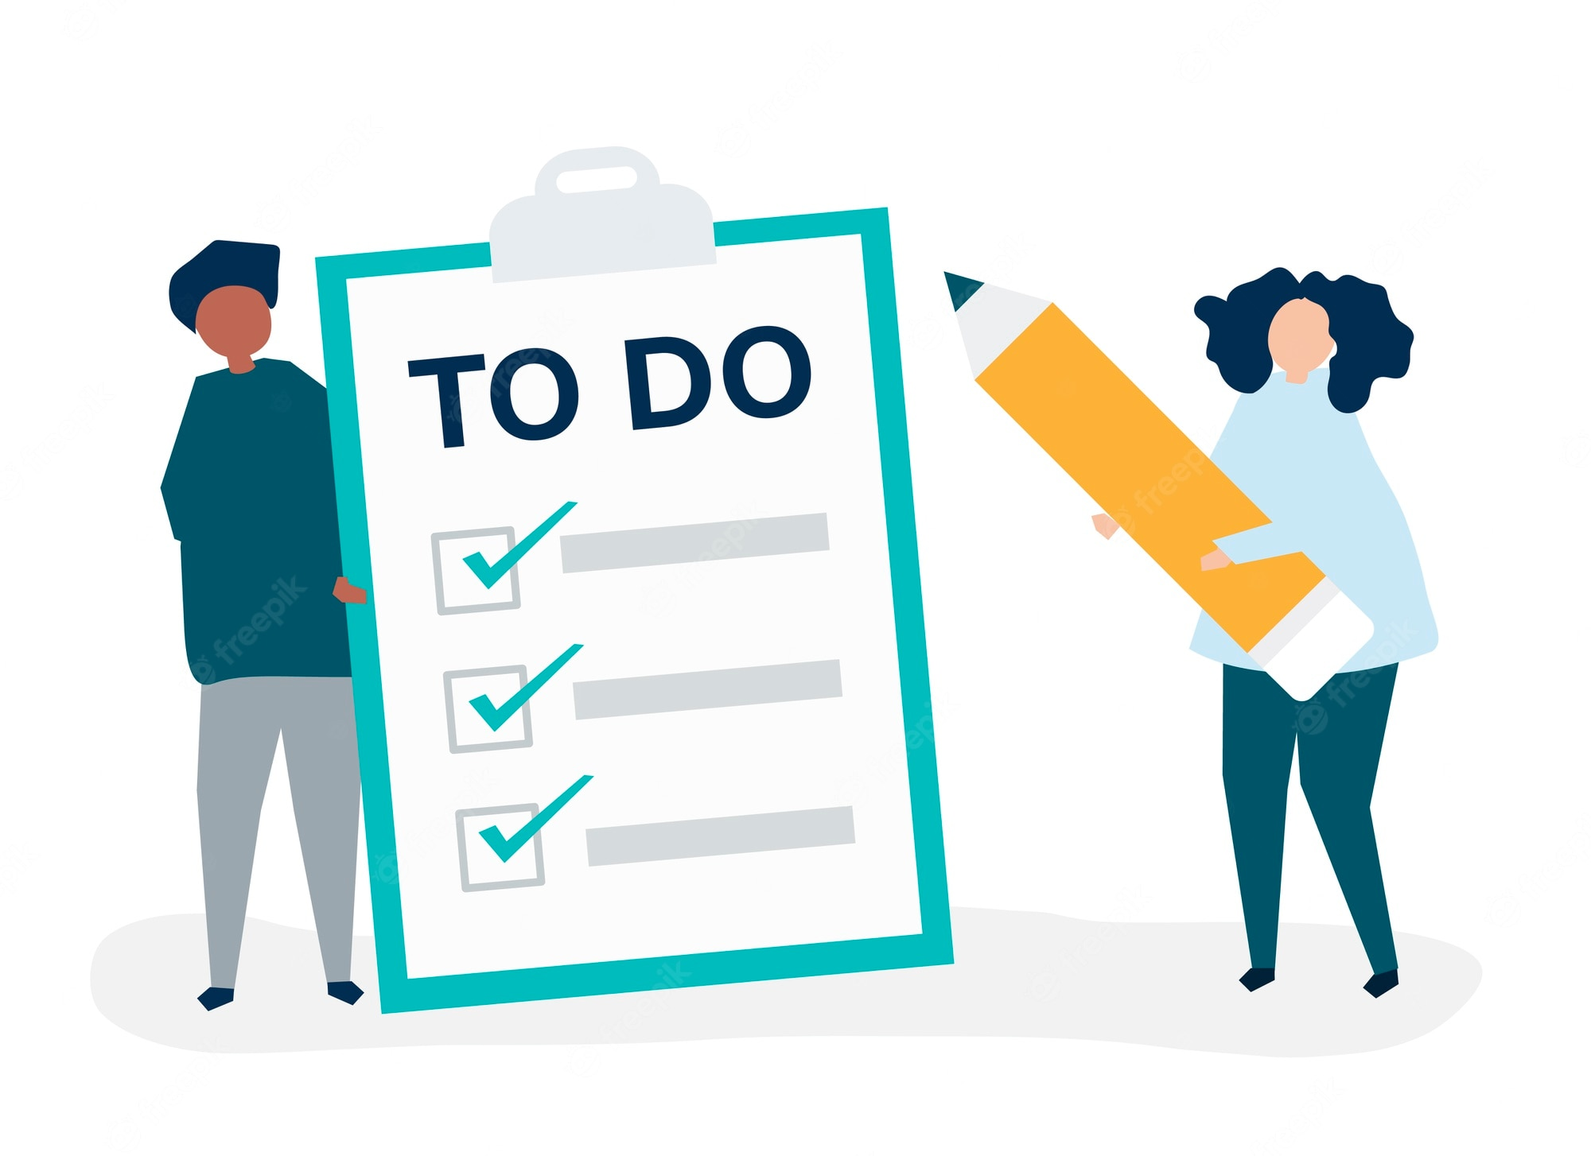
Thank you
Reach us at:
apptodo7@gmail.com
- Neil Armstrong

